Slide 1
Enterprise Apps & Agents
POWER PLATFORM
Enterprise Code App → Dataverse → AI Builder → Copilot Studio Agent → Governed Automation → Capstone Project

Slide 2
It’s easy to know where a conversation begins and ends…
START
”Text Madison ‘what’s up?’”
Send text message to Madison
Success!
Notes:
The high-level understanding of what users are going do with a conversation system is the starting point. It’s where you, as the designer, begin to understand your user’s journey and their needs – and what your system can do to meet those needs.

Slide 3
The middle is the hard part…
START
”Text Madison ‘what’s up?’”
Is ”Madison” recognized?
No, no contacts named “Madison”
Yes, 1 contact named “Madison”
Yes, >1 contact named “Madison”
”Maddy”
Does this contact have a mobile number?
Which Madison?
User input required
“Butler”
“555-555-5555”
No number
Yes, 1 number
Yes, >1 number
User input required
“555-555-5555”
“From Indiana”
“Email them instead”
User input required
User input required
“Ugh, I don’t know, cancel”
Success!
Send text message to Madison
“Um the first one”
Notes:
…but you also need to delve into the logistics behind the users’ needs and wants. What does it actually mean for your system to be able to answer this particular question or complete this particular task?
What decisions are being made “behind the scenes”? What other platforms might you need to integrate with? What might you need access to? What do your users think is going on? What assumptions are they making when they trigger this? Is your design going to align with their mental model of what’s going on?
And you also need to zoom out, and consider: how can I design this so it’s easy for the user?

Slide 4
Adding Generative AI
Notes:
The high-level understanding of what users are going do with a conversation system is the starting point. It’s where you, as the designer, begin to understand your user’s journey and their needs – and what your system can do to meet those needs.

Slide 5



Generative AI is changing building
Traditional (e.g. Azure)
Create Azure tenant and infra
Annotate thousands of utterances and conversations to build a custom NL model
Create topics in code using Visual Studio and BF SDK
Host Azure Bot Service and instantiate the appropriate channel
Deploy your copilot to the service
Build your own custom analytics pipeline
Every time your knowledge content changes (e.g. different hours) go and update the copilot in code
Manually authored topics
Anticipate and build a manual topic for each possible user question
Then keep these topics up to date as your content changes
BUSINESS CRITICALITY
Missed opportunity
Time spent hand-building topics
Conversations missed or escalated
TOPICS BUILT

Slide 6

Generative AI is changing building
Copilot Studio with Generative AI
Full E2E SaaS – no infra to host or manage
No explicit NL training or custom model required, comes with powerful large language model
Point to a knowledge sources and have a useful bot in minutes with Generative AI
Customize your copilot with business-critical topics using easy to use graphical interface and 1000s of pre-built connectors, or call custom APIs
Developers, low-code users can collaborate inside the same canvas with graphical multi-authoring and code side-by-side
Publish to the channel of your choice in minutes with a few clicks
Manually authored topics
Manually author business-critical topics quickly with Copilot Studio
BUSINESS CRITICALITY
Expose your knowledge sources and APIs and generative AI handles the rest
Vast coverage of the long tail, and as content changes, copilot answers change as well
Custom build
topics
+ help from Copilot
Topics handled by Generative Answers and Actions
TOPICS BUILT

Slide 7
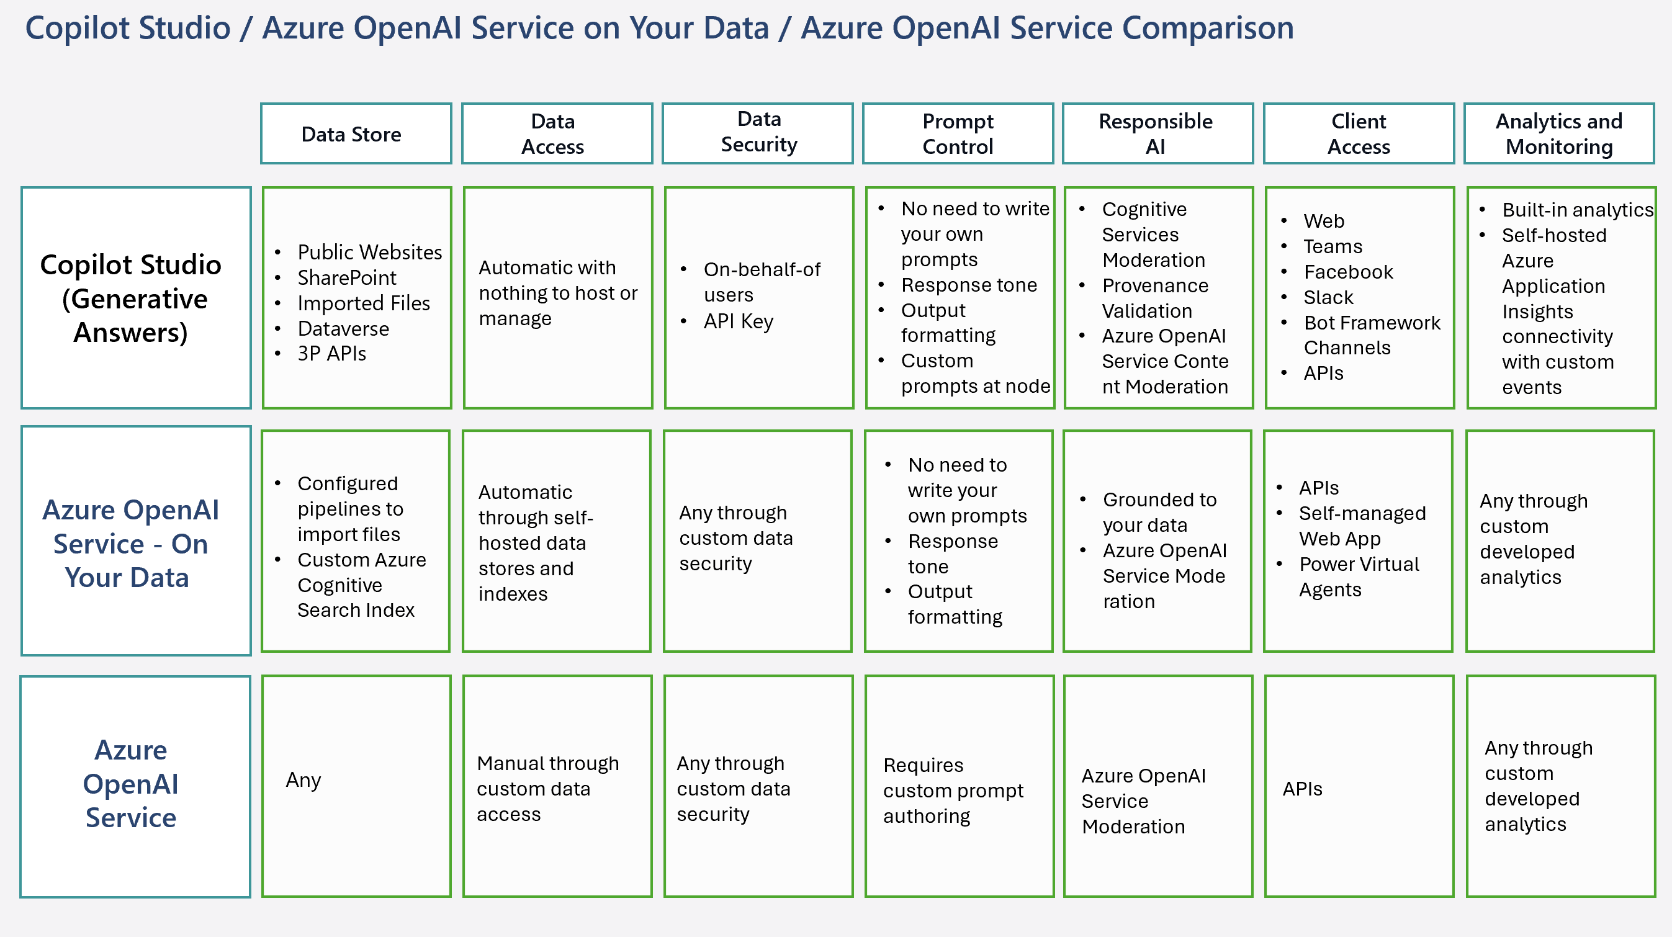
Considerations & Discovery with Generative AI

Slide 8
Generative answers vs authored topics
Authored topics
Generative answers
Deterministic, scripted flows
Trigger phrases, nodes, variables
Use for approvals, payments, actions
Answers composed from knowledge
Orchestration picks topics, tools, knowledge
Use for broad, changing questions
Prompt patterns: role + scope, answer only from sources, cite, ask to clarify, refuse out-of-scope, set tone and format.

Slide 9
Grounding, source boosting and filtering
Ground
Boost
Filter
Restrict answers to your knowledge
Turn off general web or model knowledge when scope is strict
Custom instructions define the rules
Prioritise trusted sources
Describe each source clearly so it is selected
Prefer authoritative, current content
Scope by site, folder, table or tag
Filter by user, region or product
Retrieve only what the user may see

Slide 10
Knowledge sources
Source | Best for
Dataverse | Tables and records; structured business data
SharePoint | Sites, libraries, files; respects user permissions
Fabric | Lakehouse and warehouse data via a data agent or connector
Azure AI Search | Your own index; hybrid and vector retrieval
Websites | Public URLs; good for help and docs sites
Documents | Uploaded files for small, stable content

Slide 11
RAG concepts
Chunking
Indexing
Retrieval
Freshness
Citations
Split content into passages sized to one idea
Embed and store text plus metadata and permissions
Find top passages by keyword, vector or hybrid
Re-index on change; remove stale sources
Show source links so users can verify
Retrieve first, then generate: answer quality depends on retrieval quality.

Slide 12
Responsible AI and governance
Moderation
Permissions
Audit
Set content moderation level
Block unsafe or off-topic requests
Define fallback and refusal text
Authenticate users
Retrieve with the user identity
Never expose content they cannot open
Keep conversation transcripts
Use Purview and admin logs
Review feedback and escalations

Slide 13
Testing and measures
Outcomes
Quality
Safety
Sessions and engagement
Resolution rate
Escalation and abandonment
Faithfulness to sources
Relevance and completeness
Citation accuracy
Prompt injection tests
Out-of-scope refusal
Permission leakage checks
Build a test set of real questions, run it on every change, and compare before release.

Slide 14

Demo
POWER PLATFORM
H1. Banking: configure generative answers for policy FAQs
H2. Finance: ground an expense agent on policy documents
H3. Supply Chain: configure RAG over SharePoint logistics SOPs
Notes:
Welcome. This deck walks through what you need before building your first Power Apps Code App, then the six commands that take you from a starter template to a deployed app.

Slide 15
Closing slide
Thank you

